Slide 1
Knowledge Representation

Slide 2
Outline:
Output - Knowledge representation
Decision tables
Decision trees
Decision rules
Rules involving relations
Instance-based representation
  Prototypes, Clusters
witten&eibe

Slide 3

Output: representing structural patterns
Many different ways of representing patterns
  Decision trees, rules, instance-based, …
Also called “knowledge” representation
Representation determines inference method
Understanding the output is the key to understanding the underlying learning methods
Different types of output for different learning problems (e.g. classification, regression, …)
witten&eibe

Slide 4
Decision tables
Simplest way of representing output:
  Use the same format as input!
Decision table for the weather problem:
Main problem: selecting the right attributes
Also, not flexible enough
Outlook | Humidity | Play
Sunny | High | No
Sunny | Normal | Yes
Overcast | High | Yes
Overcast | Normal | Yes
Rainy | High | No
Rainy | Normal | No
witten&eibe

Slide 5
Decision trees
“Divide-and-conquer” approach produces tree
Nodes involve testing a particular attribute
Usually, attribute value is compared to constant
Other possibilities:
  Comparing values of two attributes
  Using a function of one or more attributes
Leaves assign classification, set of classifications, or probability distribution to instances
Unknown instance is routed down the tree
witten&eibe

Slide 6
Nominal and numeric attributes
Nominal:
number of children usually equal to number values
⇒ attribute won’t get tested more than once
  Other possibility: division into two subsets
Numeric:
test whether value is greater or less than constant
⇒ attribute may get tested several times
  Other possibility: three-way split (or multi-way split)
    Integer: less than, equal to, greater than
    Real: below, within, above
witten&eibe

Slide 7
Missing values
Does absence of value have some significance?
Yes ⇒ “missing” is a separate value
No ⇒ “missing” must be treated in a special way
  Solution A: assign instance to most popular branch
  Solution B: split instance into pieces
    Pieces receive weight according to fraction of training instances that go down each branch
    Classifications from leave nodes are combined using the weights that have percolated to them
witten&eibe

Slide 8
Classification rules
Popular alternative to decision trees
Antecedent (pre-condition): a series of tests (just like the tests at the nodes of a decision tree)
Tests are usually logically ANDed together (but may also be general logical expressions)
Consequent (conclusion): classes, set of classes, or probability distribution assigned by rule
Individual rules are often logically ORed together
  Conflicts arise if different conclusions apply
witten&eibe

Slide 9
From trees to rules
Easy: converting a tree into a set of rules
  One rule for each leaf:
    Antecedent contains a condition for every node on the path from the root to the leaf
    Consequent is class assigned by the leaf
Produces rules that are unambiguous
  Doesn’t matter in which order they are executed
But: resulting rules are unnecessarily complex
  Pruning to remove redundant tests/rules
witten&eibe

Slide 10
From rules to trees
More difficult: transforming a rule set into a tree
  Tree cannot easily express disjunction between rules
Example: rules which test different attributes
Symmetry needs to be broken
Corresponding tree contains identical subtrees (⇒ “replicated subtree problem”)
If a and b then x If c and d then x
witten&eibe

Slide 11
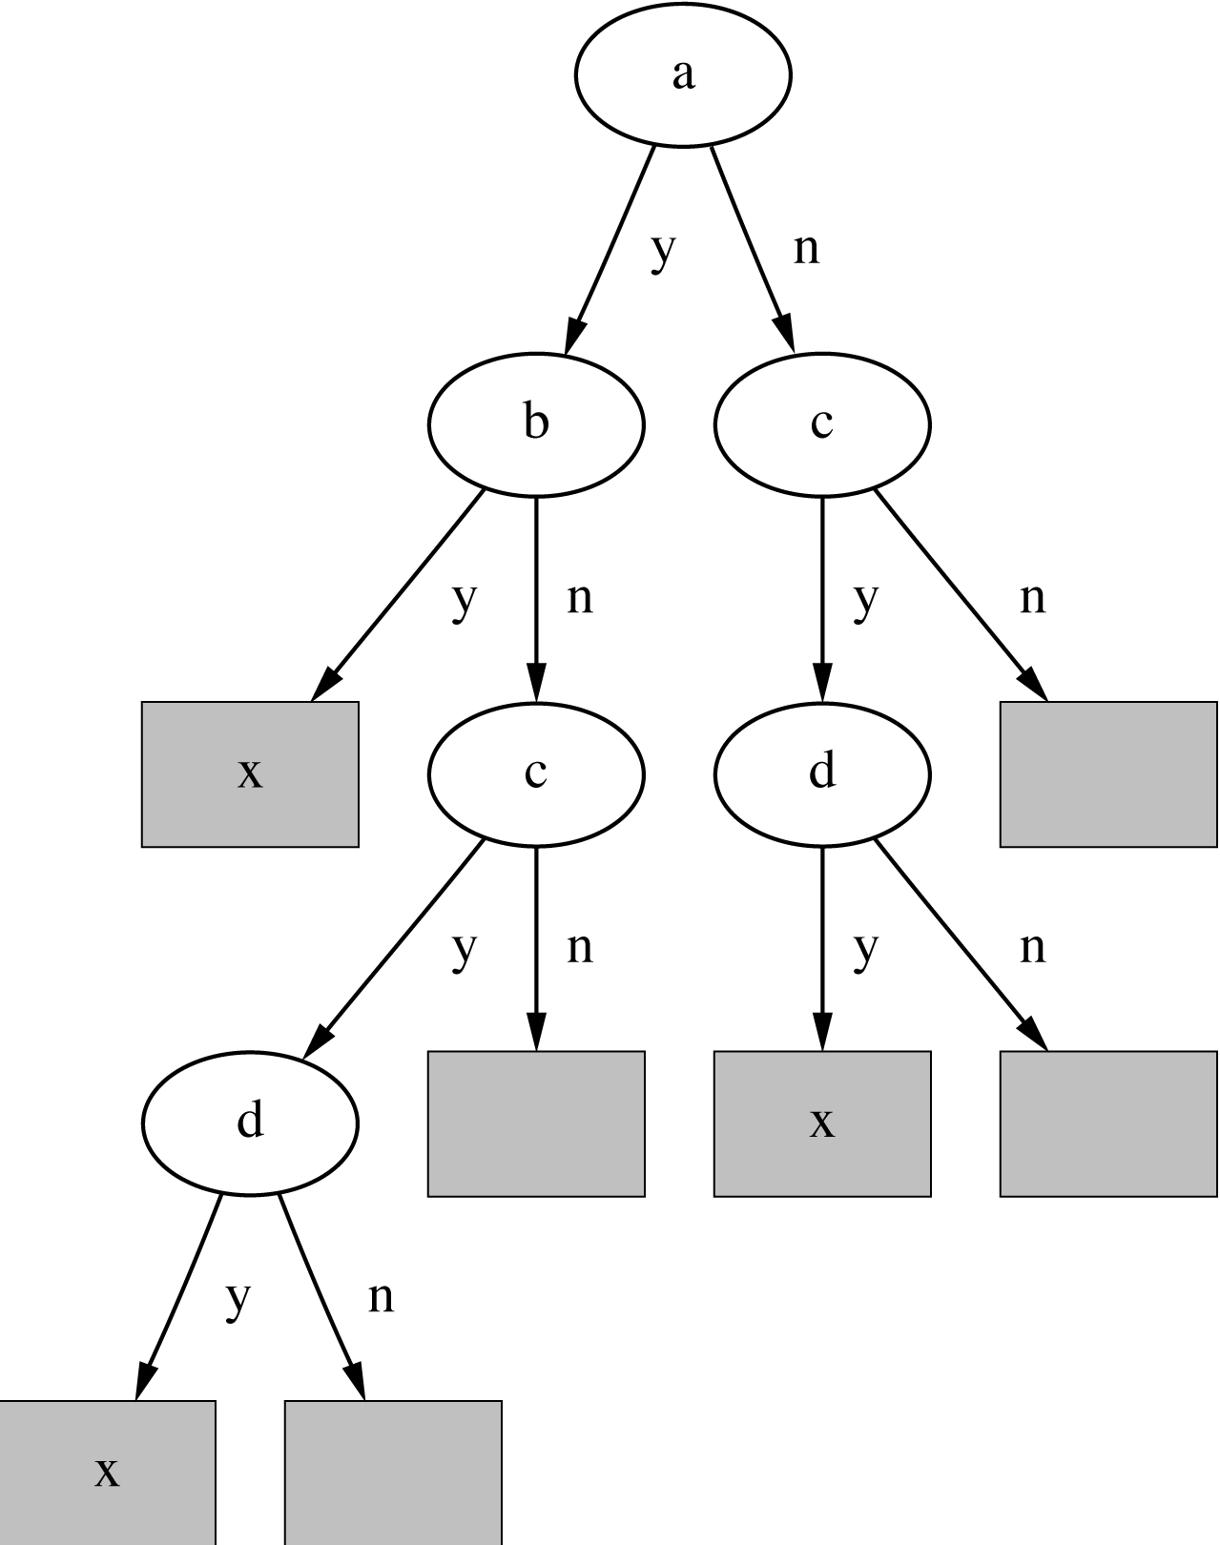
A tree for a simple disjunction
witten&eibe

Slide 12
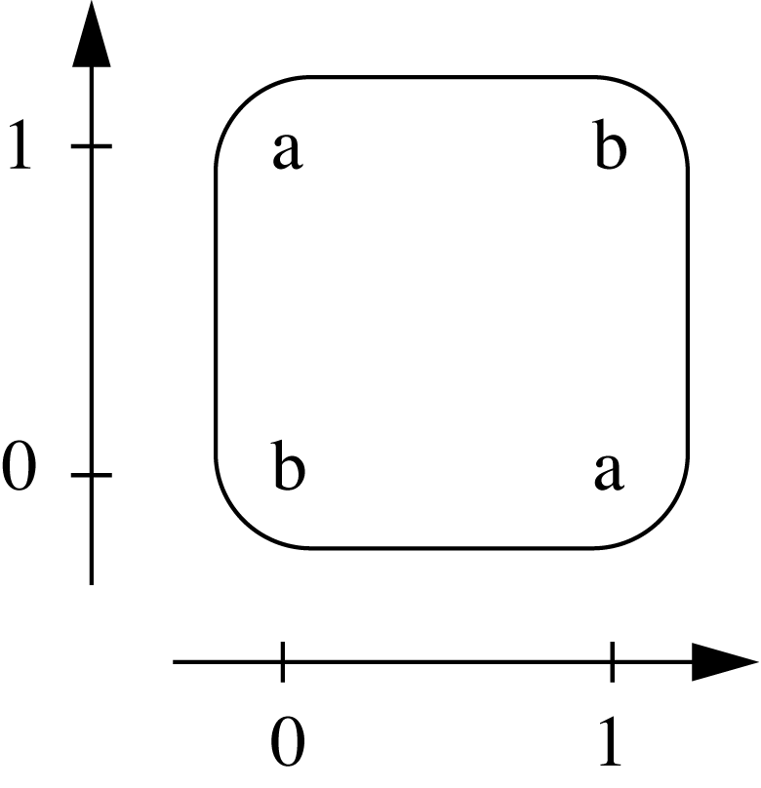
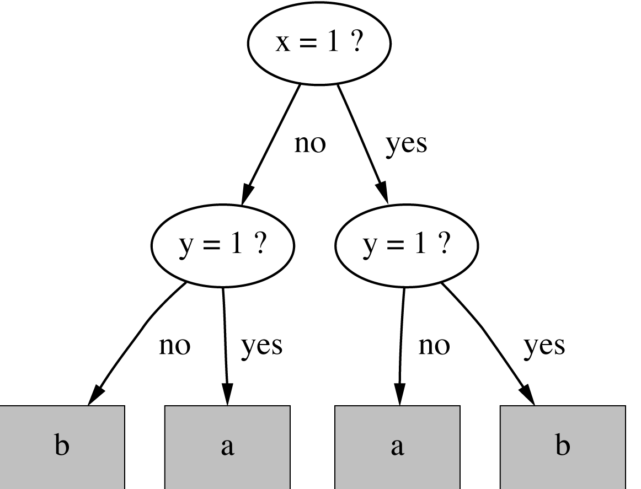
The exclusive-or problem
If x = 1 and y = 0 then class = a If x = 0 and y = 1 then class = a If x = 0 and y = 0 then class = b If x = 1 and y = 1 then class = b
witten&eibe

Slide 13
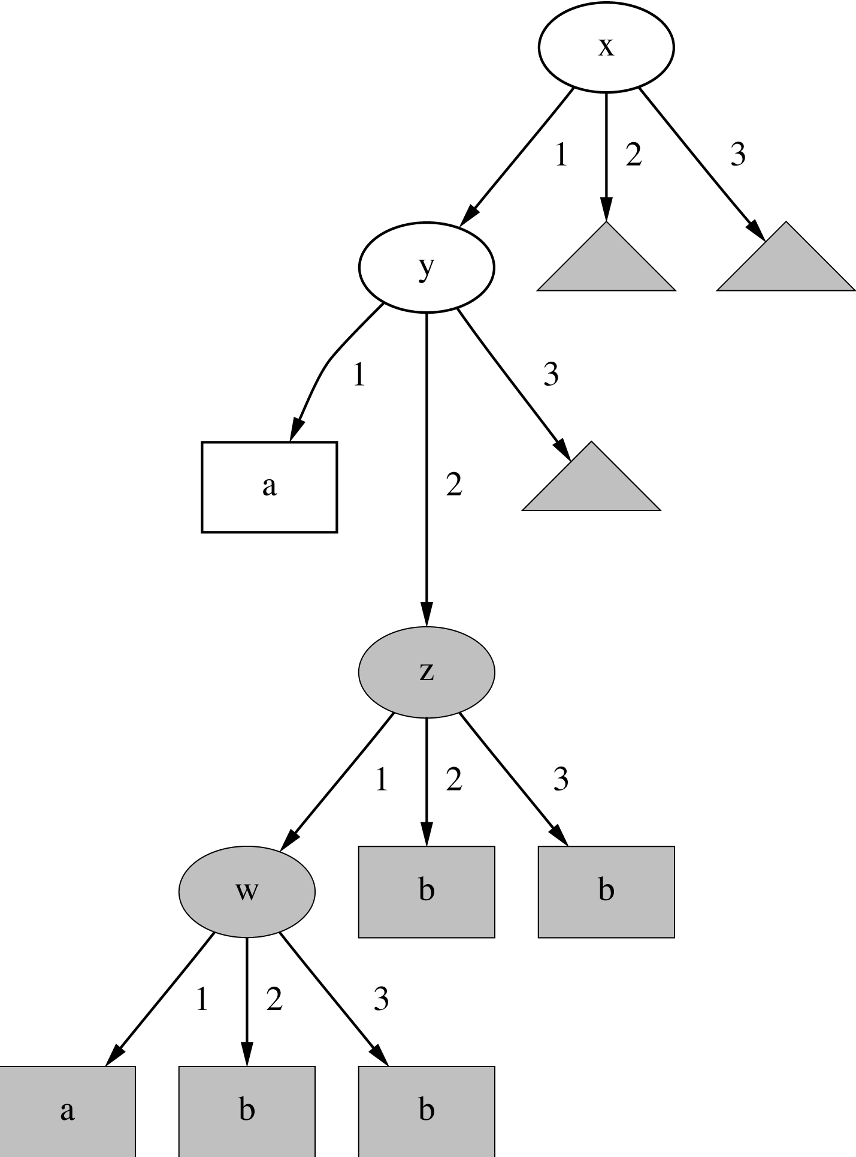
A tree with a replicated subtree
If x = 1 and y = 1 then class = a If z = 1 and w = 1 then class = a Otherwise class = b
witten&eibe

Slide 14
“Nuggets” of knowledge
Are rules independent pieces of knowledge? (It seems easy to add a rule to an existing rule base.)
Problem: ignores how rules are executed
Two ways of executing a rule set:
  Ordered set of rules (“decision list”)
    Order is important for interpretation
  Unordered set of rules
    Rules may overlap and lead to different conclusions for the same instance
witten&eibe

Slide 15
Interpreting rules
What if two or more rules conflict?
  Give no conclusion at all?
  Go with rule that is most popular on training data?
  …
What if no rule applies to a test instance?
  Give no conclusion at all?
  Go with class that is most frequent in training data?
  …
witten&eibe

Slide 16
Special case: boolean class
Assumption: if instance does not belong to class “yes”, it belongs to class “no”
Trick: only learn rules for class “yes” and use default rule for “no”
Order of rules is not important. No conflicts!
Rule can be written in disjunctive normal form
If x = 1 and y = 1 then class = a If z = 1 and w = 1 then class = a Otherwise class = b
witten&eibe

Slide 17
Rules involving relations
So far: all rules involved comparing an attribute-value to a constant (e.g. temperature < 45)
These rules are called “propositional” because they have the same expressive power as propositional logic
What if problem involves relationships between examples (e.g. family tree problem from above)?
  Can’t be expressed with propositional rules
  More expressive representation required
witten&eibe

Slide 18
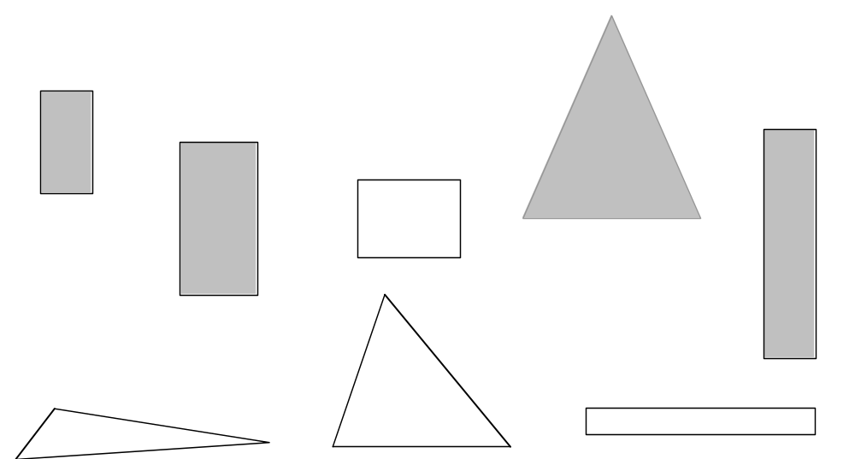
The shapes problem
Target concept: standing up
Shaded: standing
Unshaded: lying
witten&eibe

Slide 19
A propositional solution
Width | Height | Sides | Class
2 | 4 | 4 | Standing
3 | 6 | 4 | Standing
4 | 3 | 4 | Lying
7 | 8 | 3 | Standing
7 | 6 | 3 | Lying
2 | 9 | 4 | Standing
9 | 1 | 4 | Lying
10 | 2 | 3 | Lying
If width ≥ 3.5 and height < 7.0 then lying If height ≥ 3.5 then standing
witten&eibe

Slide 20
A relational solution
Comparing attributes with each other
Generalizes better to new data
Standard relations: =, <, >
But: learning relational rules is costly
Simple solution: add extra attributes
(e.g. a binary attribute is width < height?)
If width > height then lying If height > width then standing
witten&eibe

Slide 21
Rules with variables
Using variables and multiple relations:
The top of a tower of blocks is standing:
The whole tower is standing:
Recursive definition!
If height_and_width_of(x,h,w) and h > w then standing(x)
If height_and_width_of(x,h,w) and h > w and is_top_of(x,y) then standing(x)
If height_and_width_of(z,h,w) and h > w and is_top_of(x,z) and standing(y) and is_rest_of(x,y) then standing(x) If empty(x) then standing(x)
witten&eibe

Slide 22
Inductive logic programming
Recursive definition can be seen as logic program
Techniques for learning logic programs stem from the area of “inductive logic programming” (ILP)
But: recursive definitions are hard to learn
  Also: few practical problems require recursion
  Thus: many ILP techniques are restricted to non-recursive definitions to make learning easier
witten&eibe

Slide 23
Instance-based representation
Simplest form of learning: rote learning
  Training instances are searched for instance that most closely resembles new instance
  The instances themselves represent the knowledge
  Also called instance-based learning
Similarity function defines what’s “learned”
Instance-based learning is lazy learning
Methods: k-nearest-neighbor, …
witten&eibe

Slide 24
The distance function
Simplest case: one numeric attribute
  Distance is the difference between the two attribute values involved (or a function thereof)
Several numeric attributes: normally, Euclidean distance is used and attributes are normalized
Nominal attributes: distance is set to 1 if values are different, 0 if they are equal
Are all attributes equally important?
  Weighting the attributes might be necessary
witten&eibe

Slide 25
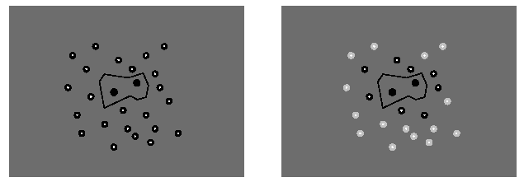
Learning prototypes
Only those instances involved in a decision need to be stored
Noisy instances should be filtered out
Idea: only use prototypical examples
witten&eibe

Slide 26
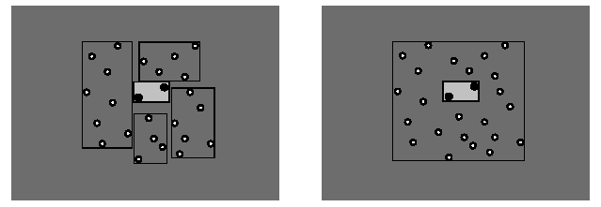
Rectangular generalizations
Nearest-neighbor rule is used outside rectangles
Rectangles are rules! (But they can be more conservative than “normal” rules.)
Nested rectangles are rules with exceptions
witten&eibe

Slide 27
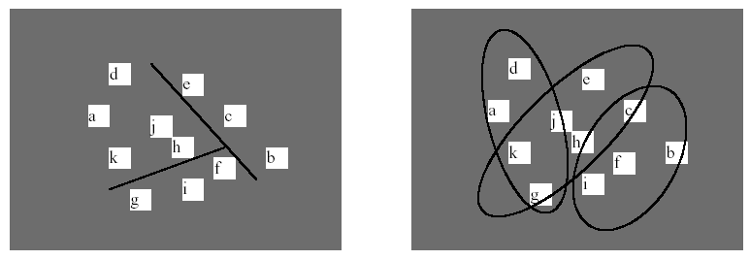
Representing clusters I
Simple 2-D representation
Venn diagram
Overlapping clusters
witten&eibe

Slide 28
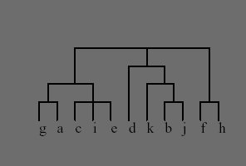
Representing clusters II
Probabilistic assignment
Dendrogram
 | 1 | 2 | 3
a | 0.4 | 0.1 | 0.5
b | 0.1 | 0.8 | 0.1
c | 0.3 | 0.3 | 0.4
d | 0.1 | 0.1 | 0.8
e | 0.4 | 0.2 | 0.4
f | 0.1 | 0.4 | 0.5
g | 0.7 | 0.2 | 0.1
h | 0.5 | 0.4 | 0.1
NB: dendron is the Greek
word for tree
witten&eibe

Slide 29
Summary
Trees
Rules
Relational representation
Instance-based representation

